Slide 1



CQRS Local - System Training
GP Reimbursement Scheme
Commissioners and GP Practices
Presented by: David O’Brien

Slide 2

Today’s Session
Who We are
Intro to the CSU Collaborative and CQRS Local and Update from NHSE
Getting Started
Session time: 30 minutes
Your CQRS Local Homepage
User Guide Location
Viewing your Claims Window
For all questions - please type them into the Chat and they will be reviewed and made available in the coming days. The Chat will not be monitored. A link to the FAQ location will be shared at the end.
Service Provider Journey
Submitting a GP Reimbursement claim
Dealing with a Declined Claim
Withdrawing and Deleting a Claim
Running a Claims Approved Report
Commissioner Journey - Tier 1 and Tier 2
Reviewing, Approving, and Declining Claims
Running a Claims Approved Report
Locating the PCSE Submission Date
Registration and FAQ Handling
Account Registration Link Distribution and FAQ

Slide 3
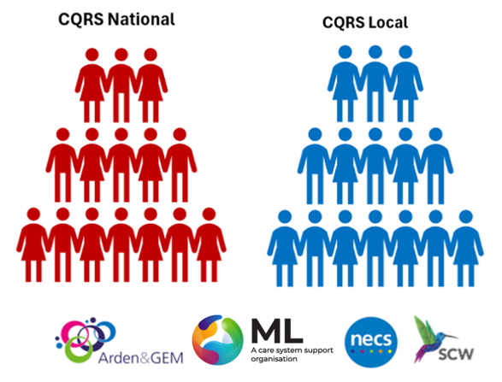
Who Are We?
Supporting both CQRS National and CQRS Local, we are a CSU Collaborative.

Slide 4
The End-to-End Process
Step 1 – GP Practice prepares and submits their GP Reimbursement claims
Including submission of future claims up to 3 months ahead – to be mentioned by NHSE)
Step 2 – Commissioner Approval Process
a) - Tier 1 – Inspecting the Claim and Approving
b) - Tier 2 – Approving the Claim for Payment (report available straight away)
Step 3 – Payment is made via PCSE (If required - Commissioners to contact the Service Desk to activate Support@CQRS.co.uk)

Slide 5
Nik Thoren
Senior Incentives Policy Lead
NHS England

Slide 6
GP Reimbursement
Scheme
Supplementary guidance: https://www.england.nhs.uk/publication/supplementary-information-to-support-changes-to-the-2026-27-gp-contract/
Practice level, separate funding to PCN ARRS
Reimbursement model – pay first, then claim
Funding - £4.57 multiplied by the practice adjusted population per practice (01/01/26). Will remain within the core GP contract recurrently beyond 2026/27. Transfer of entitlements between practices within a PCN footprint possible.
Covers the following:
  New salaried GPs (incl. Locums if holding
  an employment contract)
  Additional sessions from existing
  salaried GPs
  Continuation of a salaried GP previously funded through CAP or PCN test sites.
Does not include GP partners
Additionality principles apply, covering new and existing GPs.

Slide 7
Submission of Future Claims
New CQRS Local functionality to minimise admin burden
Future submissions – Initial claim can be replicated in the system, submitted for advance approval up to 3 months ahead, up to the end of the financial year. If details change, the practice should cancel any future submissions and generate a new claim if applicable.
Future approval – Where future submissions have been made, the ICB can pre-approve these
Payment of future approved claims – With PCSE automation, automatically generated at the end of the month
Submission deadline – Initial claim must be submitted within 3 months after the end of the month the claim relates to.s

Slide 8
System Demonstration
GP Practice: Altrincham Medical Practice - P91004
Claim Submission: GP Reimbursement Scheme
Permission has been granted by both Altrincham Medical Practice and Trafford to use their names.
This is NOT a live system and is a training platform.

Slide 9
Refer to the Chat for…..
CQRS Local Account Registration
https://local.cqrs.nhs.uk/Account/Register
If you are a member of staff that works across more than 1 site - Refer to Section 4 - Account Registration in the User Guide.
FAQ Document Location
https://welcome.cqrs.nhs.uk/service-desk/help-with-gp-reimbursement-scheme/
Please note that the Chat will not be monitored

Slide 10
What we Covered Today:
Who We Are
Locating your User Guide
Viewing your Claims Windows
Tier 1 and Tier 2 Commissioner actions:
Reviewing, Approving and Declining Claims
Running a Claims Approved Report
Locating the PCSE Submission Date
Registration and FAQ Link Shared
Service Provider Actions:
Submitting a GP Reimbursement Claim
Dealing with a Declined Claim
Withdrawing/Deleting a Claim
Running a Claims Approved Report

Slide 11
Thank you for Attending

Slide 12
Help and Support
The CQRS Local Service Desk team are here to support you. They can be contacted via telephone or email.
0330 124 4039
8am-6pm Mon-Fri (excluding public holidays)
Support@CQRS.co.uk

